Slide 1

Real Time Anomaly Detection in CCTV Surveillance
Submitted by:-
Avdhesh Chaudhary(02315002719)
Amar Sinha(04415002719)
Chirag Aggarwal(04615002719)
Under the Supervision of
Mr. Vikrant Shokeen

Slide 2
Motivation Behind The Project
Closed-circuit television (CCTV) cameras-based surveillance and control system are used to monitor violent incidents all over the world; however, identifying the occurrences involves human personnel. This human-based continuous monitoring in surveillance camera systems is error-prone because it is not humanly possible to monitor the surveillance area throughout the day and night minutely. Thus, the surveillance system should be automated.

Slide 3
Introduction
In this project we seek to improvise or make surveillance system more advanced and automated. For this we need to show in which frame and which parts of CCTV footage contain abnormal or suspicious activity . To achieve aforesaid we will be using two different neural networks CNN and RNN.
We will be using InceptionV3 by Google - a pre-trained model to apply the technique of transfer learning. The output of the RNN system is used to perform real-time surveillance on the CCTV cameras of different organizations to avoid and detect any suspicious activity. Hence, the time complexity is reduced to a great extent.

Slide 4
OBJECTIVES
The main objective of our project is to develop real time Anomaly detection in CCTV surveillance.
We approach this problem as follows :
Objectives:
1. Data Collection
2. Understanding the data
3. Data Cleaning

Slide 5
OBJECTIVES
4. Loading the training set
5. Data Preprocessing – Videos to frame Conversion
6. Transfer Learning from InceptionV3 to our CNN
7. Data Processing – Classification of Frames into categories
8. Grouping feature Maps to a Single Pattern
9. Feed to RNN

Slide 6
OBJECTIVES
10. Result of Classification
11. Inference
12. Evaluation

Slide 7
Referred Research Work
Deep Visual-Semantic Alignments for Generating Image Descriptions
Automatic Alert of Security Threat through Video Surveillance System
Threat Detection in Surveillance Videos
Real-world malicious event recognition in CCTV recording
Real-Time Anomaly Recognition Through CCTV Using Neural Networks
Towards Proactive Surveillance through CCTV Cameras

Slide 8
Reffered Resources
Data Sets:-
UCF Crime Dataset
CCTV Surveillance Dataset
Anomaly-Detection-Dataset
Resources:-
Guide to Inception v3
Google Codelabs

Slide 9
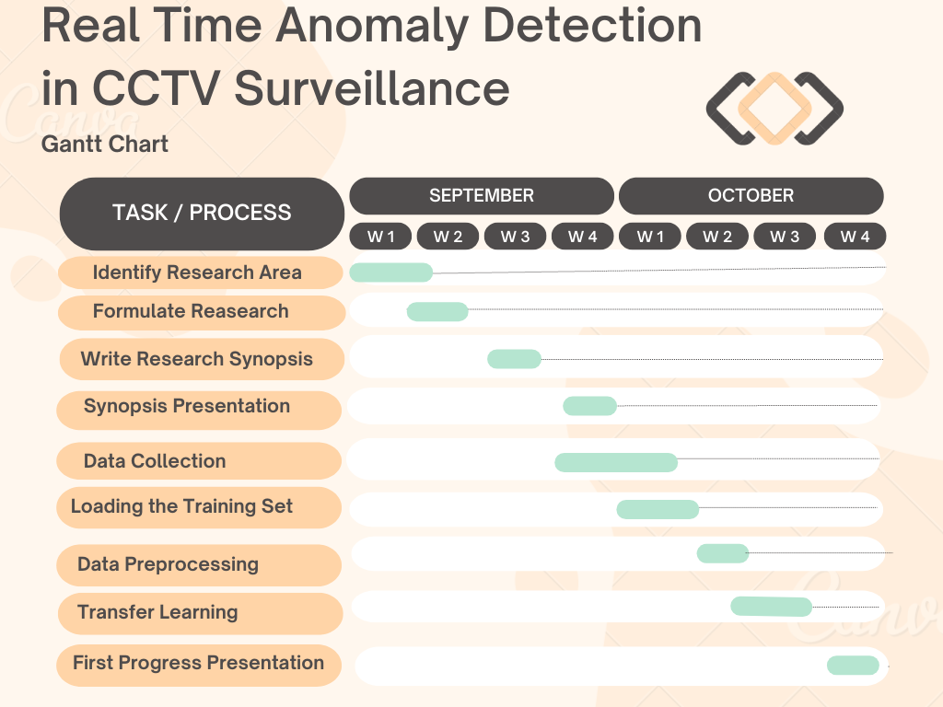

Slide 10
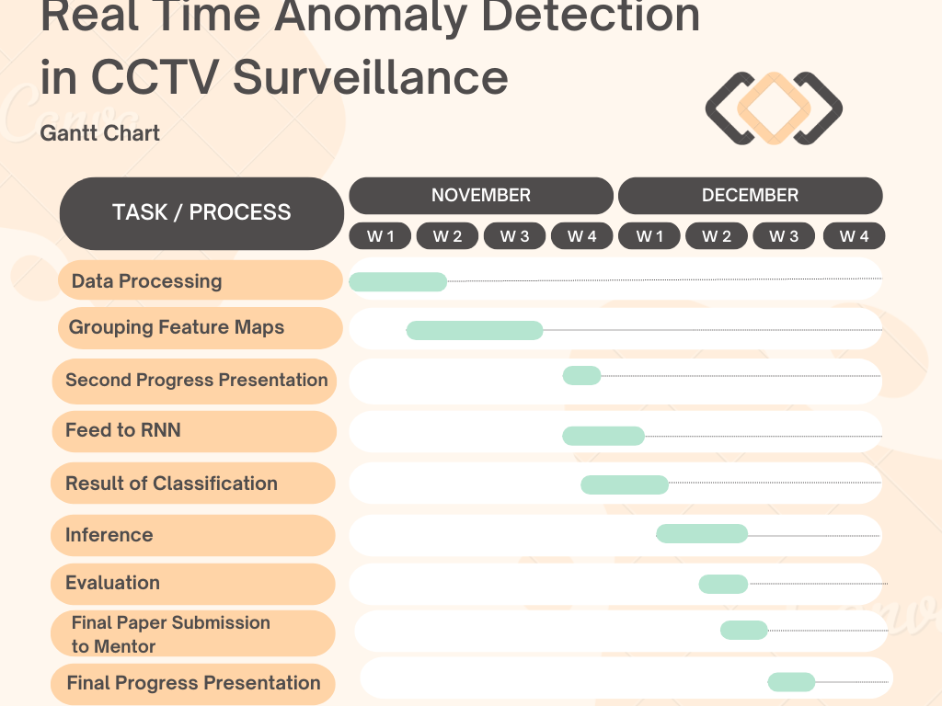

Slide 11
Thank You

